Slide 1
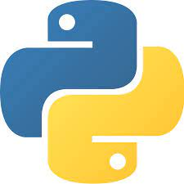
Lecture 0 INT108:: PROGRAMMING IN PYTHON (Program practice)

Slide 2
Course Overview
0 | 0 | 5
L T P :
Credit: 3
Text Book:
Fundamentals of Python –First Program Second edition by KENNETH A.LAMBERT,CENGAGE
References Book:
Python Programming: Using Problem solving approach by REEMA THAREJA, OXFORD UNIVERSITY PRESS
Introduction to Programming using Python by Y. DANIEL LIANG, PEARSON

Slide 3
Marks Breakup
Marks Breakup:
Activity | Marks
Attendance | 5
Continuous Assessment (CA)* | 65
End-Term Practical (ETP) | 30

Slide 4
CA and MTE
CA
Programming Practice using CodeTantra/EBox 40
Mini Project 15
Best 1 out of 2 MCQ Based Test 10
ETP
Programming Challenge/Hackathon based

Slide 5
Course Assessment Model
Programming Practice using CodeTantra/EBox 40
Based on number of questions attempted
0-50% ->0 Marks
51% -> 1 Marks
74% ->24 Marks
90-100% -> 40 Marks
For each % of attempted question after 50%, student will be awarded 1 mark (max up to 45 marks)

Slide 6
MOOC
https://onlinecourses.nptel.ac.in/noc21_cs32/preview
Exemptions:-
If student will provide the certificate,2 weeks prior to ETE then 1 CA will be exempted.

Slide 7
Course Objectives
define the installation of python environment and basics of Python language.
apply the condition and iteration statements for evaluating the appropriate alternates.
apply to formulate Regular Expressions and use them for Pattern Matching .
construct the core data structures like lists, dictionaries, tuples and sets in Python to store, process and sort the data.
Apply the concepts of Object-oriented programming as used in Python using encapsulation, polymorphism, and inheritance .
Apply the external modules for creating and writing data to excel files and inspect the file operations to navigate the file systems.

Slide 8

Why languages?

Slide 9

COMPUTER IS SMART ?????
https://www.youtube.com/watch?v=lfuUiBanVDM

Slide 10
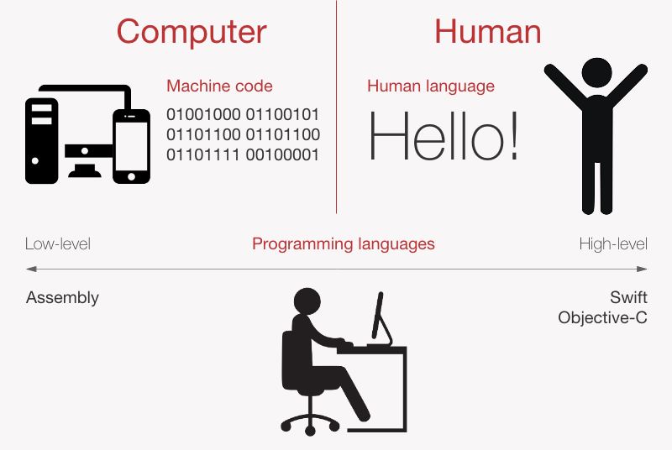
Computer Language vs. Human Language

Slide 11
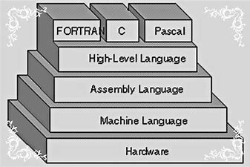
Different Computer Languages

Slide 12
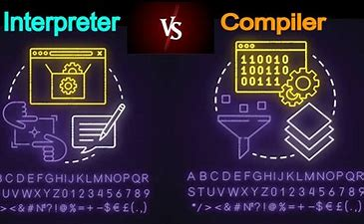
Compiler vs. Interpreter

Slide 13

Make language your Friend

Slide 14
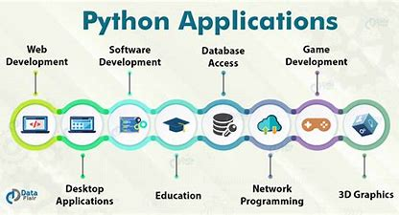

Slide 15
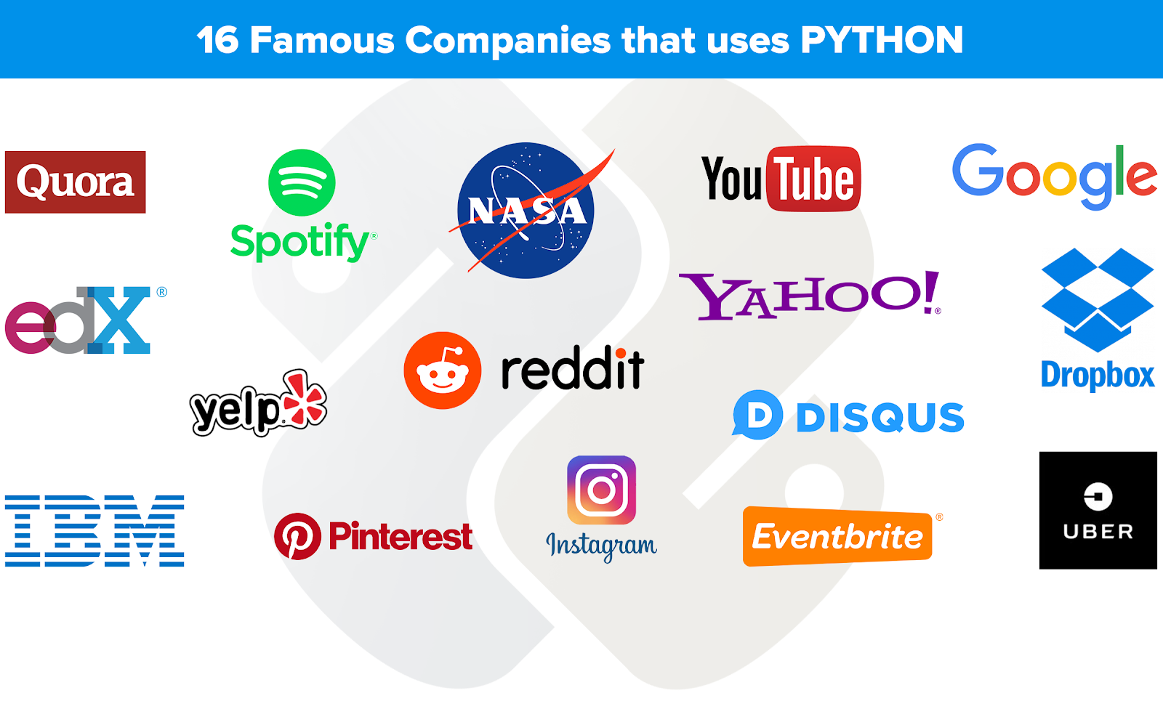

Slide 16
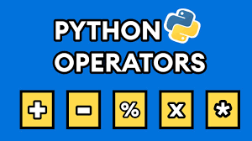
Overview of Unit 1

Slide 17
Unit 1
Setting up your Programming Environment: Python versions, Python on windows, running a ‘Hello World’ program
Variables, Expression and Statements: Naming and using variables, Avoiding Name Error when using variables, Values and types, variables, variables name and keywords, statements, operators and operand, order of operations, operations on string, composition and comments

Slide 18
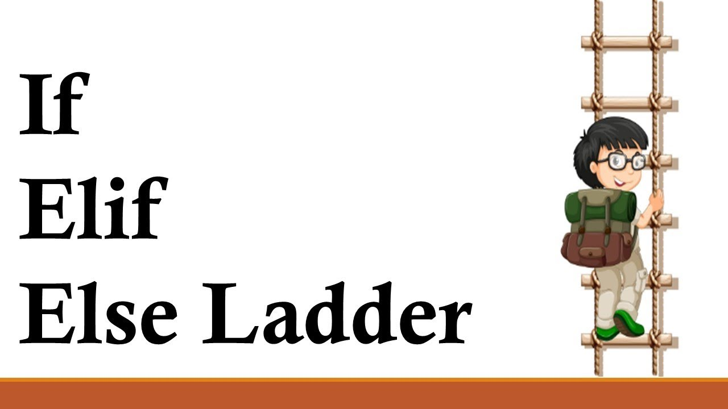
Overview of Unit 2

Slide 19
Unit 2
Conditional statements: modulus operator, Boolean expressions, logic operators, conditional, alternative execution, nested conditionals
Iterative statements: while statements, for loop statement, Nested for, Nested while, Random numbers in loops, encapsulation and generalization

Slide 20
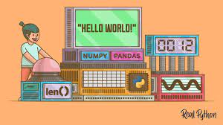
Overview of Functions and Recursion

Slide 21
Unit 3
Functions and recursion: function calls, type conversion and coercion, math functions, adding new function, parameters and argument, recursion and its use

Slide 22
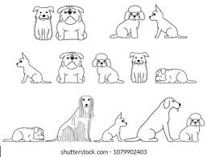
Lists and Tuples
LIST 1→
LIST2→
LIST3→

Slide 23
Unit 4
String: string a compound data type, length, string traversal, string slices, comparision, find function, looping and counting
Lists: list values, length, membership, operations, slices, deletion, accessing elements, list and for loops, list parameters and nested list.
Tuples and Dictionaries: mutability and tuples, tuple assignment, tuple as return values, dictionaries operations and methods, sparse matrices, aliasing and coping

Slide 24
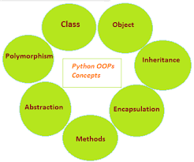
OOP

Slide 25
Unit 5
Classes and objects: Creating classes, creating instance objects, accessing attributes
Object oriented programming terminology: Class Inheritance, Overriding Methods, Data Hiding, Function Overloading

Slide 26
Unit 6
Files and Exceptions: text files, writing variables, Reading from a file, writing to a file, directories, pickling, handling the zero Division error exception, using try-except blocks, The else block, Handling the File Not found error exception
Regular Expressions – Concept of regular expression, various types of regular expressions, using match function, Web Scraping by using Regular Expressions

Slide 27
Different Python IDEs and Code Editors
IDE | Size in MB | Developed in
PyCharm | BIG | JAVA, PYTHON
Spyder | BIG | PYTHON
PyDev | MEDIUM | JAVA, PYTHON
Idle | MEDIUM | PYTHON
Wing | BIG | C, C++, PYTHON
Python Version : 3

Slide 28

Colaboratory, or "Colab" for short, allows you to write and execute Python in your browser, with
Zero configuration required
Free access to GPUs
Easy sharing

Slide 29


